Slide 1


Slide 2
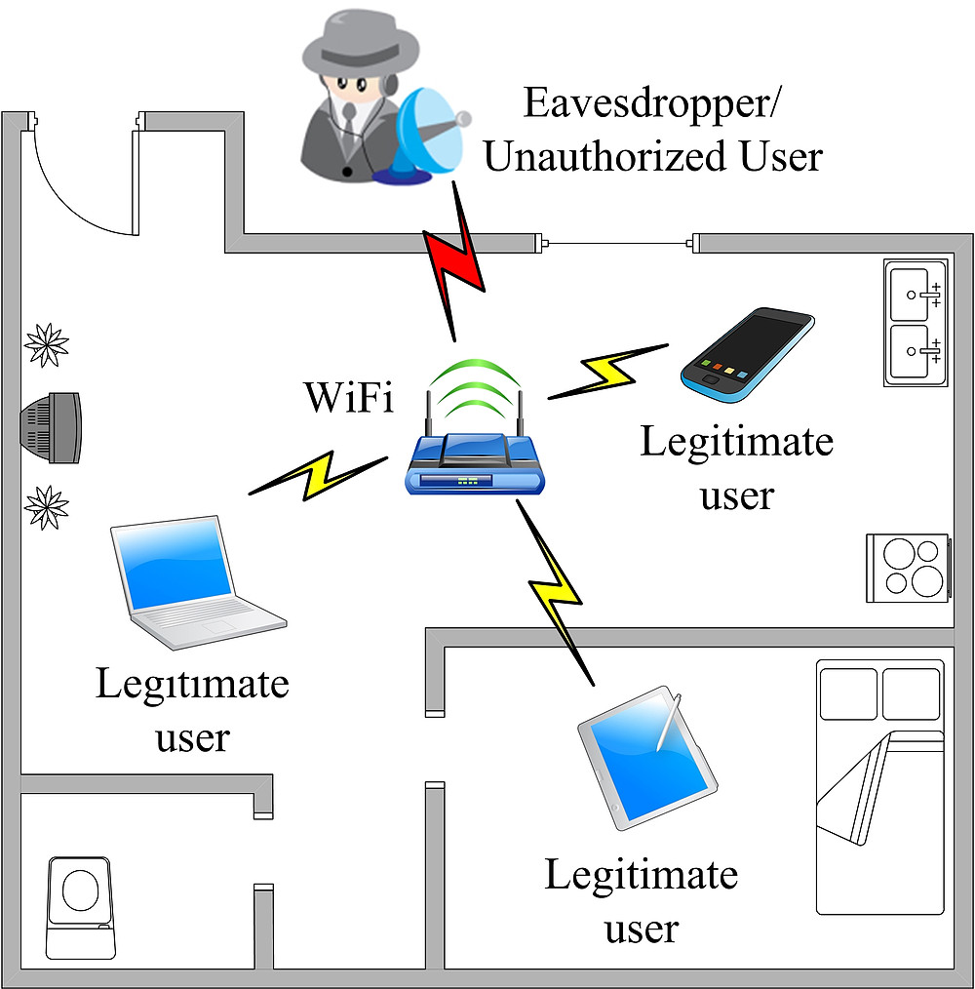
« Three can keep a secret, if two of them are dead » Benjamin Franklin

Slide 3


Slide 4


Slide 5


Slide 7


Slide 9


Slide 10


Slide 11


